Slide 1

Binary Heaps and Heapsort
Alejandro Gutierrez
CS 131, Spring 2022
West Los Angeles College
Notes:
NOTE:
To change the image on this slide, select the picture and delete it. Then click the Pictures icon in the placeholder to insert your own image.

Slide 2
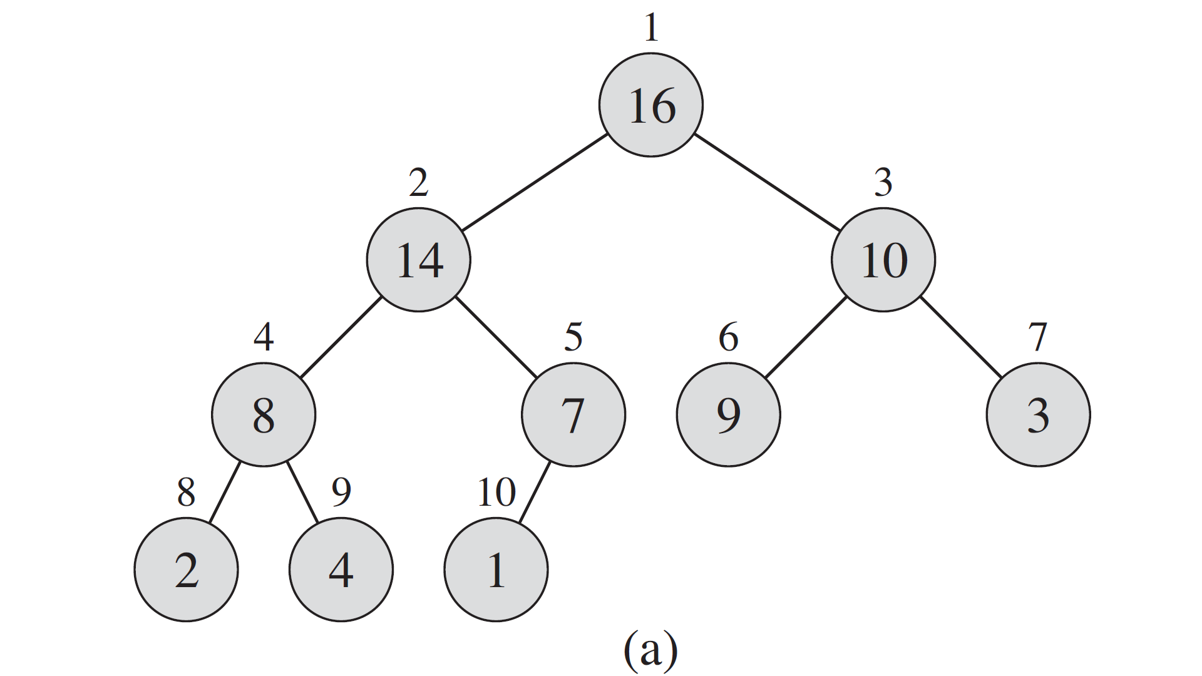
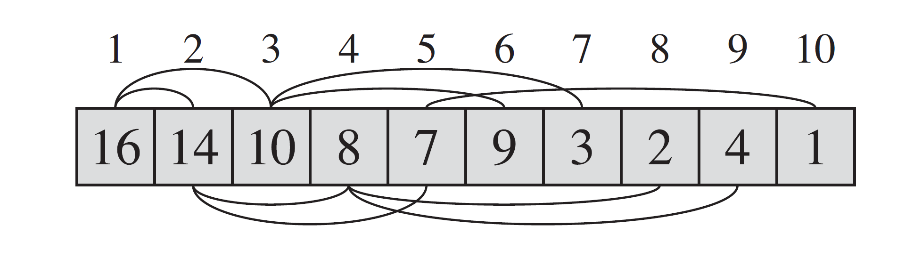
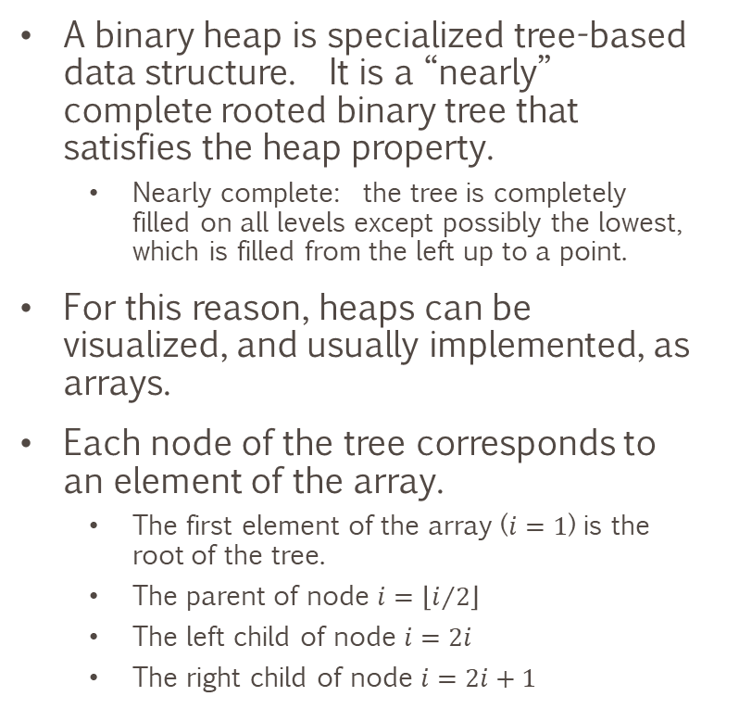
What is a Binary Heap
A binary heap is specialized tree-based data structure. It is a “nearly” complete rooted binary tree that satisfies the heap property.
Nearly complete: the tree is completely filled on all levels except possibly the lowest, which is filled from the left up to a point.
For this reason, heaps can be visualized, and usually implemented, as arrays.
Each node of the tree corresponds to an element of the array.
The first element of the array ($i=1$) is the root of the tree.
The parent of node $i=\left\lfloor i/2\right\rfloor$
The left child of node $i=2i$
The right child of node $i=2i+1$
Notes:
Cormen, T. H., Leiserson, C. E., Rivest, R. L., & Stein, C. (2009). Introduction to algorithms. Mit Press.

Slide 3
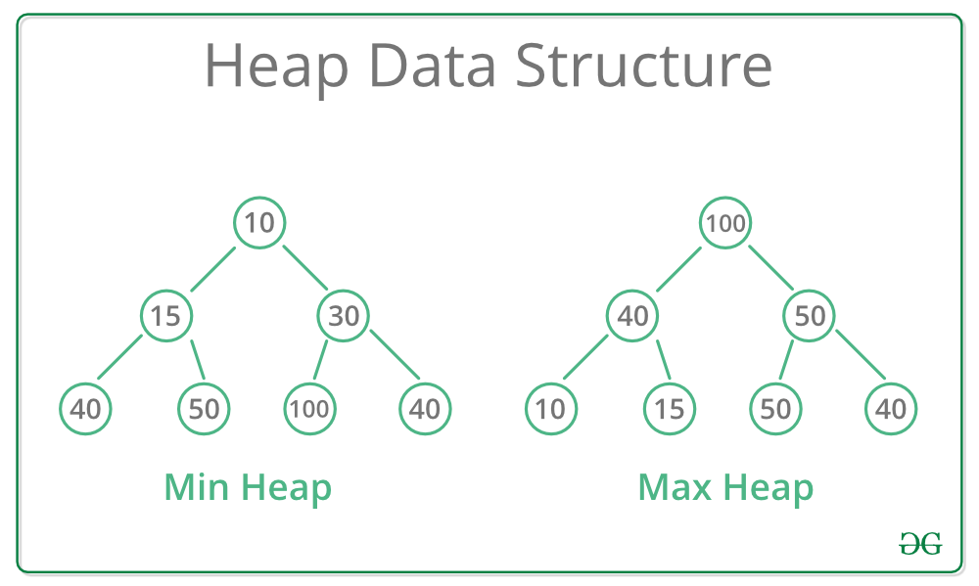
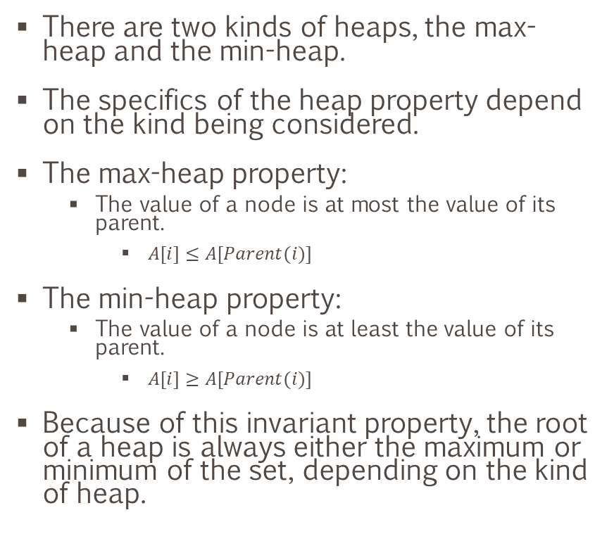
The Heap Property
There are two kinds of heaps, the max-heap and the min-heap.
The specifics of the heap property depend on the kind being considered.
The max-heap property:
The value of a node is at most the value of its parent.
$A[i]≤A[Parent(i)]$
The min-heap property:
The value of a node is at least the value of its parent.
$A[i]≥A[Parent(i)]$
Because of this invariant property, the root of a heap is always either the maximum or minimum of the set, depending on the kind of heap.
Notes:
https://www.geeksforgeeks.org/heap-data-structure/

Slide 4
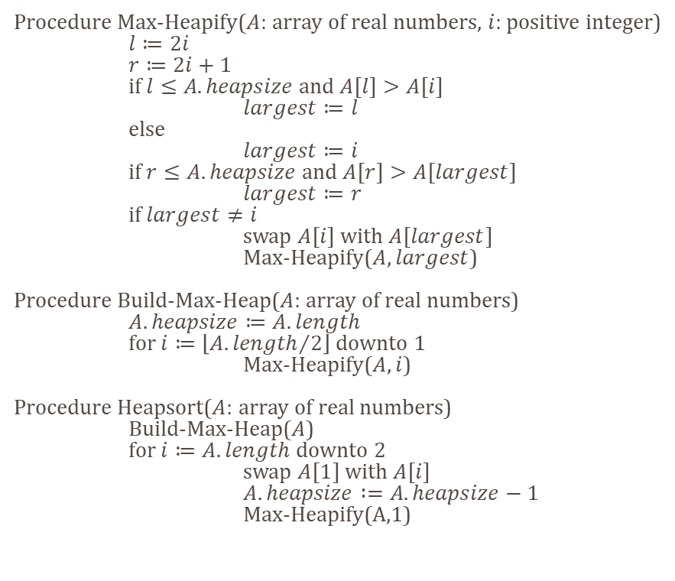
Heapsort
Invented by J.W.J. Williams in 1964, heapsort is a comparison-based sorting technique that relies on the binary heap data structure. It is similar to selection sort where we have a sorted region and an unsorted region. We fill the sorted region by moving the maximum element of the unsorted region (the heap) to the sorted region. We then repeat the same process for the remaining elements in the unsorted region.
The selection of the maximum element is a trivial operation due to the max-heap property.
Procedure Max-Heapify($A$: array of real numbers, $i$: positive integer)
$l≔2i$
$r≔2i+1$
if $l≤A.heapsize$ and $A[l]>A[i]$
$largest≔l$
else
$largest≔i$
if $r≤A.heapsize$ and $A[r]>A[largest]$
$largest≔r$
if $largest≠i$
swap $A[i]$ with $A[largest]$
Max-Heapify($A, largest$)
Procedure Build-Max-Heap($A$: array of real numbers)
$A.heapsize≔A.length$
for $i≔\left\lfloor {A.length}/2\right\rfloor$ downto $1$
Max-Heapify($A, i$)
Procedure Heapsort($A$: array of real numbers)
Build-Max-Heap($A$)
for $i≔A.length$ downto $2$
swap $A[1]$ with $A[i]$
$A.heapsize :=A.heapsize−1$
Max-Heapify(A,1)

Slide 5
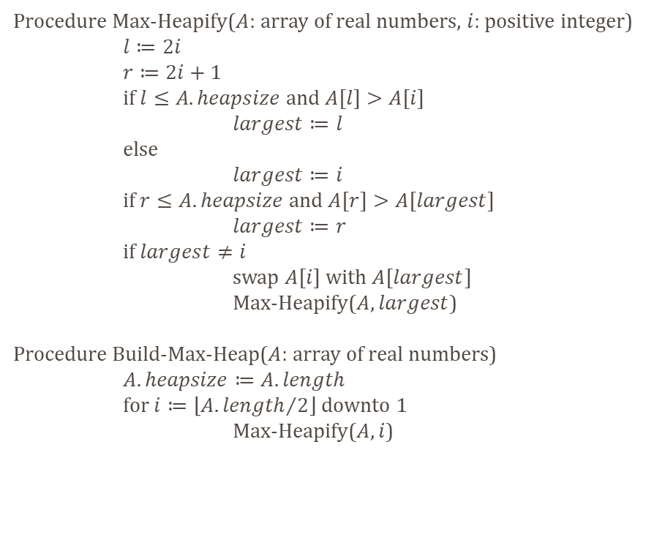
Heapifying a Binary Tree
Procedure Max-Heapify($A$: array of real numbers, $i$: positive integer)
$l≔2i$
$r≔2i+1$
if $l≤A.heapsize$ and $A[l]>A[i]$
$largest≔l$
else
$largest≔i$
if $r≤A.heapsize$ and $A[r]>A[largest]$
$largest≔r$
if $largest≠i$
swap $A[i]$ with $A[largest]$
Max-Heapify($A, largest$)
Procedure Build-Max-Heap($A$: array of real numbers)
$A.heapsize≔A.length$
for $i≔\left\lfloor {A.length}/2\right\rfloor$ downto $1$
Max-Heapify($A, i$)
1
9
2
3
12
3
4
5
40
37
1
2
3
4
5
9
12
3
40
37

Slide 6
Heapifying a Binary Tree
Procedure Max-Heapify($A$: array of real numbers, $i$: positive integer)
$l≔2i$
$r≔2i+1$
if $l≤A.heapsize$ and $A[l]>A[i]$
$largest≔l$
else
$largest≔i$
if $r≤A.heapsize$ and $A[r]>A[largest]$
$largest≔r$
if $largest≠i$
swap $A[i]$ with $A[largest]$
Max-Heapify($A, largest$)
Procedure Build-Max-Heap($A$: array of real numbers)
$A.heapsize≔A.length$
for $i≔\left\lfloor {A.length}/2\right\rfloor$ downto $1$
Max-Heapify($A, i$)
1
9
2
3
12
3
4
5
40
37
1
2
3
4
5
9
12
3
40
37

Slide 7
Heapifying a Binary Tree
Procedure Max-Heapify($A$: array of real numbers, $i$: positive integer)
$l≔2i$
$r≔2i+1$
if $l≤A.heapsize$ and $A[l]>A[i]$
$largest≔l$
else
$largest≔i$
if $r≤A.heapsize$ and $A[r]>A[largest]$
$largest≔r$
if $largest≠i$
swap $A[i]$ with $A[largest]$
Max-Heapify($A, largest$)
Procedure Build-Max-Heap($A$: array of real numbers)
$A.heapsize≔A.length$
for $i≔\left\lfloor {A.length}/2\right\rfloor$ downto $1$
Max-Heapify($A, i$)
1
9
2
3
40
3
4
5
12
37
1
2
3
4
5
9
40
3
12
37

Slide 8
Heapifying a Binary Tree
Procedure Max-Heapify($A$: array of real numbers, $i$: positive integer)
$l≔2i$
$r≔2i+1$
if $l≤A.heapsize$ and $A[l]>A[i]$
$largest≔l$
else
$largest≔i$
if $r≤A.heapsize$ and $A[r]>A[largest]$
$largest≔r$
if $largest≠i$
swap $A[i]$ with $A[largest]$
Max-Heapify($A, largest$)
Procedure Build-Max-Heap($A$: array of real numbers)
$A.heapsize≔A.length$
for $i≔\left\lfloor {A.length}/2\right\rfloor$ downto $1$
Max-Heapify($A, i$)
1
9
2
3
40
3
4
5
12
37
1
2
3
4
5
9
40
3
12
37

Slide 9
Heapifying a Binary Tree
Procedure Max-Heapify($A$: array of real numbers, $i$: positive integer)
$l≔2i$
$r≔2i+1$
if $l≤A.heapsize$ and $A[l]>A[i]$
$largest≔l$
else
$largest≔i$
if $r≤A.heapsize$ and $A[r]>A[largest]$
$largest≔r$
if $largest≠i$
swap $A[i]$ with $A[largest]$
Max-Heapify($A, largest$)
Procedure Build-Max-Heap($A$: array of real numbers)
$A.heapsize≔A.length$
for $i≔\left\lfloor {A.length}/2\right\rfloor$ downto $1$
Max-Heapify($A, i$)
1
9
2
3
40
3
4
5
12
37
1
2
3
4
5
9
40
3
12
37

Slide 10
Heapifying a Binary Tree
Procedure Max-Heapify($A$: array of real numbers, $i$: positive integer)
$l≔2i$
$r≔2i+1$
if $l≤A.heapsize$ and $A[l]>A[i]$
$largest≔l$
else
$largest≔i$
if $r≤A.heapsize$ and $A[r]>A[largest]$
$largest≔r$
if $largest≠i$
swap $A[i]$ with $A[largest]$
Max-Heapify($A, largest$)
Procedure Build-Max-Heap($A$: array of real numbers)
$A.heapsize≔A.length$
for $i≔\left\lfloor {A.length}/2\right\rfloor$ downto $1$
Max-Heapify($A, i$)
1
40
2
3
9
3
4
5
12
37
1
2
3
4
5
40
9
3
12
37

Slide 11
Heapifying a Binary Tree
Procedure Max-Heapify($A$: array of real numbers, $i$: positive integer)
$l≔2i$
$r≔2i+1$
if $l≤A.heapsize$ and $A[l]>A[i]$
$largest≔l$
else
$largest≔i$
if $r≤A.heapsize$ and $A[r]>A[largest]$
$largest≔r$
if $largest≠i$
swap $A[i]$ with $A[largest]$
Max-Heapify($A, largest$)
Procedure Build-Max-Heap($A$: array of real numbers)
$A.heapsize≔A.length$
for $i≔\left\lfloor {A.length}/2\right\rfloor$ downto $1$
Max-Heapify($A, i$)
1
40
2
3
9
3
4
5
12
37
1
2
3
4
5
40
9
3
12
37

Slide 12
Heapifying a Binary Tree
Procedure Max-Heapify($A$: array of real numbers, $i$: positive integer)
$l≔2i$
$r≔2i+1$
if $l≤A.heapsize$ and $A[l]>A[i]$
$largest≔l$
else
$largest≔i$
if $r≤A.heapsize$ and $A[r]>A[largest]$
$largest≔r$
if $largest≠i$
swap $A[i]$ with $A[largest]$
Max-Heapify($A, largest$)
Procedure Build-Max-Heap($A$: array of real numbers)
$A.heapsize≔A.length$
for $i≔\left\lfloor {A.length}/2\right\rfloor$ downto $1$
Max-Heapify($A, i$)
1
40
2
3
9
3
4
5
12
37
1
2
3
4
5
40
9
3
12
37

Slide 13
Heapifying a Binary Tree
Procedure Max-Heapify($A$: array of real numbers, $i$: positive integer)
$l≔2i$
$r≔2i+1$
if $l≤A.heapsize$ and $A[l]>A[i]$
$largest≔l$
else
$largest≔i$
if $r≤A.heapsize$ and $A[r]>A[largest]$
$largest≔r$
if $largest≠i$
swap $A[i]$ with $A[largest]$
Max-Heapify($A, largest$)
Procedure Build-Max-Heap($A$: array of real numbers)
$A.heapsize≔A.length$
for $i≔\left\lfloor {A.length}/2\right\rfloor$ downto $1$
Max-Heapify($A, i$)
1
40
2
3
37
3
4
5
12
9
1
2
3
4
5
40
37
3
12
9

Slide 14
Heapifying a Binary Tree
Procedure Max-Heapify($A$: array of real numbers, $i$: positive integer)
$l≔2i$
$r≔2i+1$
if $l≤A.heapsize$ and $A[l]>A[i]$
$largest≔l$
else
$largest≔i$
if $r≤A.heapsize$ and $A[r]>A[largest]$
$largest≔r$
if $largest≠i$
swap $A[i]$ with $A[largest]$
Max-Heapify($A, largest$)
Procedure Build-Max-Heap($A$: array of real numbers)
$A.heapsize≔A.length$
for $i≔\left\lfloor {A.length}/2\right\rfloor$ downto $1$
Max-Heapify($A, i$)
1
40
2
3
37
3
4
5
12
9
1
2
3
4
5
40
37
3
12
9

Slide 15
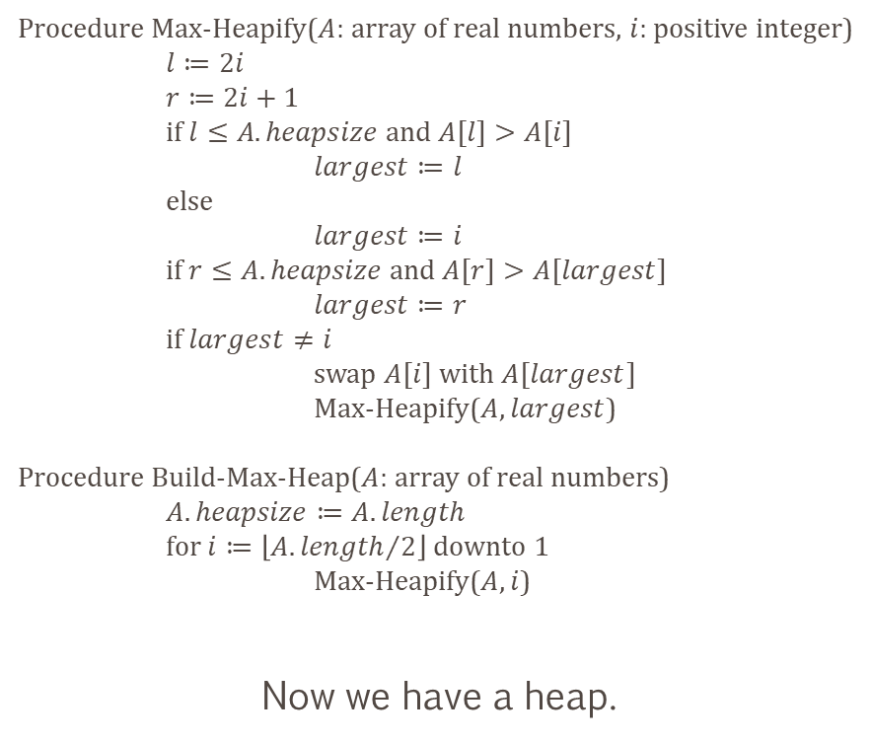
Heapifying a Binary Tree
Procedure Max-Heapify($A$: array of real numbers, $i$: positive integer)
$l≔2i$
$r≔2i+1$
if $l≤A.heapsize$ and $A[l]>A[i]$
$largest≔l$
else
$largest≔i$
if $r≤A.heapsize$ and $A[r]>A[largest]$
$largest≔r$
if $largest≠i$
swap $A[i]$ with $A[largest]$
Max-Heapify($A, largest$)
Procedure Build-Max-Heap($A$: array of real numbers)
$A.heapsize≔A.length$
for $i≔\left\lfloor {A.length}/2\right\rfloor$ downto $1$
Max-Heapify($A, i$)
Now we have a heap.
1
40
2
3
37
3
4
5
12
9
1
2
3
4
5
40
37
3
12
9

Slide 16
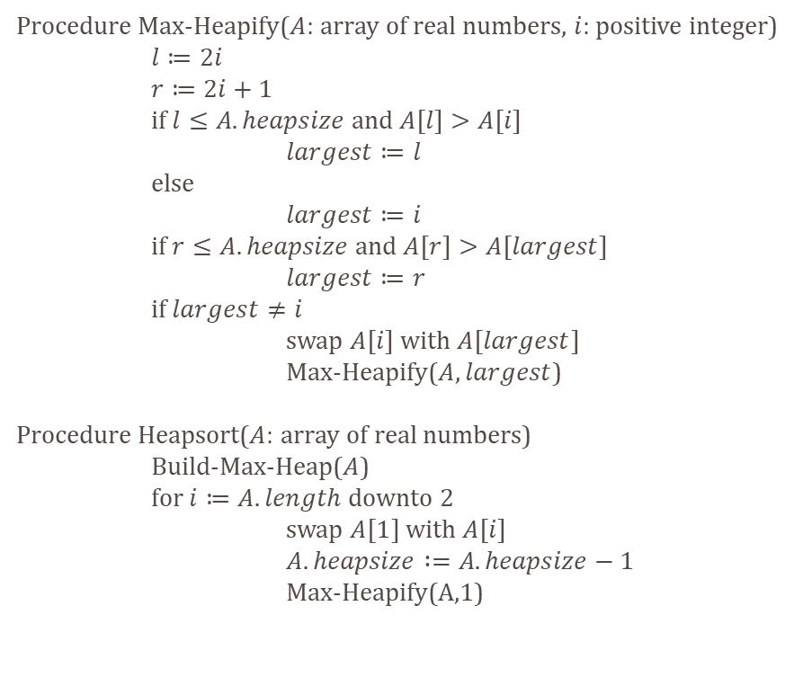
Sorting the Heap
Procedure Max-Heapify($A$: array of real numbers, $i$: positive integer)
$l≔2i$
$r≔2i+1$
if $l≤A.heapsize$ and $A[l]>A[i]$
$largest≔l$
else
$largest≔i$
if $r≤A.heapsize$ and $A[r]>A[largest]$
$largest≔r$
if $largest≠i$
swap $A[i]$ with $A[largest]$
Max-Heapify($A, largest$)
Procedure Heapsort($A$: array of real numbers)
Build-Max-Heap($A$)
for $i≔A.length$ downto $2$
swap $A[1]$ with $A[i]$
$A.heapsize :=A.heapsize−1$
Max-Heapify(A,1)
1
40
2
3
37
3
4
5
12
9
1
2
3
4
5
40
37
3
12
9

Slide 17
Sorting the Heap
Procedure Max-Heapify($A$: array of real numbers, $i$: positive integer)
$l≔2i$
$r≔2i+1$
if $l≤A.heapsize$ and $A[l]>A[i]$
$largest≔l$
else
$largest≔i$
if $r≤A.heapsize$ and $A[r]>A[largest]$
$largest≔r$
if $largest≠i$
swap $A[i]$ with $A[largest]$
Max-Heapify($A, largest$)
Procedure Heapsort($A$: array of real numbers)
Build-Max-Heap($A$)
for $i≔A.length$ downto $2$
swap $A[1]$ with $A[i]$
$A.heapsize :=A.heapsize−1$
Max-Heapify(A,1)
1
40
2
3
37
3
4
5
12
9
1
2
3
4
5
40
37
3
12
9

Slide 18
Sorting the Heap
Procedure Max-Heapify($A$: array of real numbers, $i$: positive integer)
$l≔2i$
$r≔2i+1$
if $l≤A.heapsize$ and $A[l]>A[i]$
$largest≔l$
else
$largest≔i$
if $r≤A.heapsize$ and $A[r]>A[largest]$
$largest≔r$
if $largest≠i$
swap $A[i]$ with $A[largest]$
Max-Heapify($A, largest$)
Procedure Heapsort($A$: array of real numbers)
Build-Max-Heap($A$)
for $i≔A.length$ downto $2$
swap $A[1]$ with $A[i]$
$A.heapsize :=A.heapsize−1$
Max-Heapify(A,1)
1
9
2
3
37
3
4
5
12
40
1
2
3
4
5
9
37
3
12
40

Slide 19
Sorting the Heap
Procedure Max-Heapify($A$: array of real numbers, $i$: positive integer)
$l≔2i$
$r≔2i+1$
if $l≤A.heapsize$ and $A[l]>A[i]$
$largest≔l$
else
$largest≔i$
if $r≤A.heapsize$ and $A[r]>A[largest]$
$largest≔r$
if $largest≠i$
swap $A[i]$ with $A[largest]$
Max-Heapify($A, largest$)
Procedure Heapsort($A$: array of real numbers)
Build-Max-Heap($A$)
for $i≔A.length$ downto $2$
swap $A[1]$ with $A[i]$
$A.heapsize :=A.heapsize−1$
Max-Heapify(A,1)
1
9
2
3
37
3
4
5
12
40
1
2
3
4
5
9
37
3
12
40

Slide 20
Sorting the Heap
Procedure Max-Heapify($A$: array of real numbers, $i$: positive integer)
$l≔2i$
$r≔2i+1$
if $l≤A.heapsize$ and $A[l]>A[i]$
$largest≔l$
else
$largest≔i$
if $r≤A.heapsize$ and $A[r]>A[largest]$
$largest≔r$
if $largest≠i$
swap $A[i]$ with $A[largest]$
Max-Heapify($A, largest$)
Procedure Heapsort($A$: array of real numbers)
Build-Max-Heap($A$)
for $i≔A.length$ downto $2$
swap $A[1]$ with $A[i]$
$A.heapsize :=A.heapsize−1$
Max-Heapify(A,1)
1
9
2
3
37
3
4
12
1
2
3
4
5
9
37
3
12
40

Slide 21
Sorting the Heap
Procedure Max-Heapify($A$: array of real numbers, $i$: positive integer)
$l≔2i$
$r≔2i+1$
if $l≤A.heapsize$ and $A[l]>A[i]$
$largest≔l$
else
$largest≔i$
if $r≤A.heapsize$ and $A[r]>A[largest]$
$largest≔r$
if $largest≠i$
swap $A[i]$ with $A[largest]$
Max-Heapify($A, largest$)
Procedure Heapsort($A$: array of real numbers)
Build-Max-Heap($A$)
for $i≔A.length$ downto $2$
swap $A[1]$ with $A[i]$
$A.heapsize :=A.heapsize−1$
Max-Heapify(A,1)
1
9
2
3
37
3
4
12
1
2
3
4
5
9
37
3
12
40

Slide 22
Sorting the Heap
Procedure Max-Heapify($A$: array of real numbers, $i$: positive integer)
$l≔2i$
$r≔2i+1$
if $l≤A.heapsize$ and $A[l]>A[i]$
$largest≔l$
else
$largest≔i$
if $r≤A.heapsize$ and $A[r]>A[largest]$
$largest≔r$
if $largest≠i$
swap $A[i]$ with $A[largest]$
Max-Heapify($A, largest$)
Procedure Heapsort($A$: array of real numbers)
Build-Max-Heap($A$)
for $i≔A.length$ downto $2$
swap $A[1]$ with $A[i]$
$A.heapsize :=A.heapsize−1$
Max-Heapify(A,1)
1
9
2
3
37
3
4
12
1
2
3
4
5
9
37
3
12
40

Slide 23
Sorting the Heap
Procedure Max-Heapify($A$: array of real numbers, $i$: positive integer)
$l≔2i$
$r≔2i+1$
if $l≤A.heapsize$ and $A[l]>A[i]$
$largest≔l$
else
$largest≔i$
if $r≤A.heapsize$ and $A[r]>A[largest]$
$largest≔r$
if $largest≠i$
swap $A[i]$ with $A[largest]$
Max-Heapify($A, largest$)
Procedure Heapsort($A$: array of real numbers)
Build-Max-Heap($A$)
for $i≔A.length$ downto $2$
swap $A[1]$ with $A[i]$
$A.heapsize :=A.heapsize−1$
Max-Heapify(A,1)
1
37
2
3
9
3
4
12
1
2
3
4
5
37
9
3
12
40

Slide 24
Sorting the Heap
Procedure Max-Heapify($A$: array of real numbers, $i$: positive integer)
$l≔2i$
$r≔2i+1$
if $l≤A.heapsize$ and $A[l]>A[i]$
$largest≔l$
else
$largest≔i$
if $r≤A.heapsize$ and $A[r]>A[largest]$
$largest≔r$
if $largest≠i$
swap $A[i]$ with $A[largest]$
Max-Heapify($A, largest$)
Procedure Heapsort($A$: array of real numbers)
Build-Max-Heap($A$)
for $i≔A.length$ downto $2$
swap $A[1]$ with $A[i]$
$A.heapsize :=A.heapsize−1$
Max-Heapify(A,1)
1
37
2
3
9
3
4
12
1
2
3
4
5
37
9
3
12
40

Slide 25
Sorting the Heap
Procedure Max-Heapify($A$: array of real numbers, $i$: positive integer)
$l≔2i$
$r≔2i+1$
if $l≤A.heapsize$ and $A[l]>A[i]$
$largest≔l$
else
$largest≔i$
if $r≤A.heapsize$ and $A[r]>A[largest]$
$largest≔r$
if $largest≠i$
swap $A[i]$ with $A[largest]$
Max-Heapify($A, largest$)
Procedure Heapsort($A$: array of real numbers)
Build-Max-Heap($A$)
for $i≔A.length$ downto $2$
swap $A[1]$ with $A[i]$
$A.heapsize :=A.heapsize−1$
Max-Heapify(A,1)
1
37
2
3
9
3
4
12
1
2
3
4
5
37
9
3
12
40

Slide 26
Sorting the Heap
Procedure Max-Heapify($A$: array of real numbers, $i$: positive integer)
$l≔2i$
$r≔2i+1$
if $l≤A.heapsize$ and $A[l]>A[i]$
$largest≔l$
else
$largest≔i$
if $r≤A.heapsize$ and $A[r]>A[largest]$
$largest≔r$
if $largest≠i$
swap $A[i]$ with $A[largest]$
Max-Heapify($A, largest$)
Procedure Heapsort($A$: array of real numbers)
Build-Max-Heap($A$)
for $i≔A.length$ downto $2$
swap $A[1]$ with $A[i]$
$A.heapsize :=A.heapsize−1$
Max-Heapify(A,1)
1
37
2
3
12
3
4
9
1
2
3
4
5
37
12
3
9
40

Slide 27
Sorting the Heap
Procedure Max-Heapify($A$: array of real numbers, $i$: positive integer)
$l≔2i$
$r≔2i+1$
if $l≤A.heapsize$ and $A[l]>A[i]$
$largest≔l$
else
$largest≔i$
if $r≤A.heapsize$ and $A[r]>A[largest]$
$largest≔r$
if $largest≠i$
swap $A[i]$ with $A[largest]$
Max-Heapify($A, largest$)
Procedure Heapsort($A$: array of real numbers)
Build-Max-Heap($A$)
for $i≔A.length$ downto $2$
swap $A[1]$ with $A[i]$
$A.heapsize :=A.heapsize−1$
Max-Heapify(A,1)
1
37
2
3
12
3
4
9
1
2
3
4
5
37
12
3
9
40

Slide 28
Sorting the Heap
Procedure Max-Heapify($A$: array of real numbers, $i$: positive integer)
$l≔2i$
$r≔2i+1$
if $l≤A.heapsize$ and $A[l]>A[i]$
$largest≔l$
else
$largest≔i$
if $r≤A.heapsize$ and $A[r]>A[largest]$
$largest≔r$
if $largest≠i$
swap $A[i]$ with $A[largest]$
Max-Heapify($A, largest$)
Procedure Heapsort($A$: array of real numbers)
Build-Max-Heap($A$)
for $i≔A.length$ downto $2$
swap $A[1]$ with $A[i]$
$A.heapsize :=A.heapsize−1$
Max-Heapify(A,1)
1
37
2
3
12
3
4
9
1
2
3
4
5
37
12
3
9
40

Slide 29
Sorting the Heap
Procedure Max-Heapify($A$: array of real numbers, $i$: positive integer)
$l≔2i$
$r≔2i+1$
if $l≤A.heapsize$ and $A[l]>A[i]$
$largest≔l$
else
$largest≔i$
if $r≤A.heapsize$ and $A[r]>A[largest]$
$largest≔r$
if $largest≠i$
swap $A[i]$ with $A[largest]$
Max-Heapify($A, largest$)
Procedure Heapsort($A$: array of real numbers)
Build-Max-Heap($A$)
for $i≔A.length$ downto $2$
swap $A[1]$ with $A[i]$
$A.heapsize :=A.heapsize−1$
Max-Heapify(A,1)
1
37
2
3
12
3
4
9
1
2
3
4
5
37
12
3
9
40

Slide 30
Sorting the Heap
Procedure Max-Heapify($A$: array of real numbers, $i$: positive integer)
$l≔2i$
$r≔2i+1$
if $l≤A.heapsize$ and $A[l]>A[i]$
$largest≔l$
else
$largest≔i$
if $r≤A.heapsize$ and $A[r]>A[largest]$
$largest≔r$
if $largest≠i$
swap $A[i]$ with $A[largest]$
Max-Heapify($A, largest$)
Procedure Heapsort($A$: array of real numbers)
Build-Max-Heap($A$)
for $i≔A.length$ downto $2$
swap $A[1]$ with $A[i]$
$A.heapsize :=A.heapsize−1$
Max-Heapify(A,1)
1
9
2
3
12
3
4
37
1
2
3
4
5
9
12
3
37
40

Slide 31
Sorting the Heap
Procedure Max-Heapify($A$: array of real numbers, $i$: positive integer)
$l≔2i$
$r≔2i+1$
if $l≤A.heapsize$ and $A[l]>A[i]$
$largest≔l$
else
$largest≔i$
if $r≤A.heapsize$ and $A[r]>A[largest]$
$largest≔r$
if $largest≠i$
swap $A[i]$ with $A[largest]$
Max-Heapify($A, largest$)
Procedure Heapsort($A$: array of real numbers)
Build-Max-Heap($A$)
for $i≔A.length$ downto $2$
swap $A[1]$ with $A[i]$
$A.heapsize :=A.heapsize−1$
Max-Heapify(A,1)
1
9
2
3
12
3
4
37
1
2
3
4
5
9
12
3
37
40

Slide 32
Sorting the Heap
Procedure Max-Heapify($A$: array of real numbers, $i$: positive integer)
$l≔2i$
$r≔2i+1$
if $l≤A.heapsize$ and $A[l]>A[i]$
$largest≔l$
else
$largest≔i$
if $r≤A.heapsize$ and $A[r]>A[largest]$
$largest≔r$
if $largest≠i$
swap $A[i]$ with $A[largest]$
Max-Heapify($A, largest$)
Procedure Heapsort($A$: array of real numbers)
Build-Max-Heap($A$)
for $i≔A.length$ downto $2$
swap $A[1]$ with $A[i]$
$A.heapsize :=A.heapsize−1$
Max-Heapify(A,1)
1
9
2
3
12
3
1
2
3
4
5
9
12
3
37
40

Slide 33
Sorting the Heap
Procedure Max-Heapify($A$: array of real numbers, $i$: positive integer)
$l≔2i$
$r≔2i+1$
if $l≤A.heapsize$ and $A[l]>A[i]$
$largest≔l$
else
$largest≔i$
if $r≤A.heapsize$ and $A[r]>A[largest]$
$largest≔r$
if $largest≠i$
swap $A[i]$ with $A[largest]$
Max-Heapify($A, largest$)
Procedure Heapsort($A$: array of real numbers)
Build-Max-Heap($A$)
for $i≔A.length$ downto $2$
swap $A[1]$ with $A[i]$
$A.heapsize :=A.heapsize−1$
Max-Heapify(A,1)
1
9
2
3
12
3
1
2
3
4
5
9
12
3
37
40

Slide 34
Sorting the Heap
Procedure Max-Heapify($A$: array of real numbers, $i$: positive integer)
$l≔2i$
$r≔2i+1$
if $l≤A.heapsize$ and $A[l]>A[i]$
$largest≔l$
else
$largest≔i$
if $r≤A.heapsize$ and $A[r]>A[largest]$
$largest≔r$
if $largest≠i$
swap $A[i]$ with $A[largest]$
Max-Heapify($A, largest$)
Procedure Heapsort($A$: array of real numbers)
Build-Max-Heap($A$)
for $i≔A.length$ downto $2$
swap $A[1]$ with $A[i]$
$A.heapsize :=A.heapsize−1$
Max-Heapify(A,1)
1
9
2
3
12
3
1
2
3
4
5
9
12
3
37
40

Slide 35
Sorting the Heap
Procedure Max-Heapify($A$: array of real numbers, $i$: positive integer)
$l≔2i$
$r≔2i+1$
if $l≤A.heapsize$ and $A[l]>A[i]$
$largest≔l$
else
$largest≔i$
if $r≤A.heapsize$ and $A[r]>A[largest]$
$largest≔r$
if $largest≠i$
swap $A[i]$ with $A[largest]$
Max-Heapify($A, largest$)
Procedure Heapsort($A$: array of real numbers)
Build-Max-Heap($A$)
for $i≔A.length$ downto $2$
swap $A[1]$ with $A[i]$
$A.heapsize :=A.heapsize−1$
Max-Heapify(A,1)
1
12
2
3
9
3
1
2
3
4
5
12
9
3
37
40

Slide 36
Sorting the Heap
Procedure Max-Heapify($A$: array of real numbers, $i$: positive integer)
$l≔2i$
$r≔2i+1$
if $l≤A.heapsize$ and $A[l]>A[i]$
$largest≔l$
else
$largest≔i$
if $r≤A.heapsize$ and $A[r]>A[largest]$
$largest≔r$
if $largest≠i$
swap $A[i]$ with $A[largest]$
Max-Heapify($A, largest$)
Procedure Heapsort($A$: array of real numbers)
Build-Max-Heap($A$)
for $i≔A.length$ downto $2$
swap $A[1]$ with $A[i]$
$A.heapsize :=A.heapsize−1$
Max-Heapify(A,1)
1
12
2
3
9
3
1
2
3
4
5
12
9
3
37
40

Slide 37
Sorting the Heap
Procedure Max-Heapify($A$: array of real numbers, $i$: positive integer)
$l≔2i$
$r≔2i+1$
if $l≤A.heapsize$ and $A[l]>A[i]$
$largest≔l$
else
$largest≔i$
if $r≤A.heapsize$ and $A[r]>A[largest]$
$largest≔r$
if $largest≠i$
swap $A[i]$ with $A[largest]$
Max-Heapify($A, largest$)
Procedure Heapsort($A$: array of real numbers)
Build-Max-Heap($A$)
for $i≔A.length$ downto $2$
swap $A[1]$ with $A[i]$
$A.heapsize :=A.heapsize−1$
Max-Heapify(A,1)
1
12
2
3
9
3
1
2
3
4
5
12
9
3
37
40

Slide 38
Sorting the Heap
Procedure Max-Heapify($A$: array of real numbers, $i$: positive integer)
$l≔2i$
$r≔2i+1$
if $l≤A.heapsize$ and $A[l]>A[i]$
$largest≔l$
else
$largest≔i$
if $r≤A.heapsize$ and $A[r]>A[largest]$
$largest≔r$
if $largest≠i$
swap $A[i]$ with $A[largest]$
Max-Heapify($A, largest$)
Procedure Heapsort($A$: array of real numbers)
Build-Max-Heap($A$)
for $i≔A.length$ downto $2$
swap $A[1]$ with $A[i]$
$A.heapsize :=A.heapsize−1$
Max-Heapify(A,1)
1
12
2
3
9
3
1
2
3
4
5
12
9
3
37
40

Slide 39
Sorting the Heap
Procedure Max-Heapify($A$: array of real numbers, $i$: positive integer)
$l≔2i$
$r≔2i+1$
if $l≤A.heapsize$ and $A[l]>A[i]$
$largest≔l$
else
$largest≔i$
if $r≤A.heapsize$ and $A[r]>A[largest]$
$largest≔r$
if $largest≠i$
swap $A[i]$ with $A[largest]$
Max-Heapify($A, largest$)
Procedure Heapsort($A$: array of real numbers)
Build-Max-Heap($A$)
for $i≔A.length$ downto $2$
swap $A[1]$ with $A[i]$
$A.heapsize :=A.heapsize−1$
Max-Heapify(A,1)
1
3
2
3
9
12
1
2
3
4
5
3
9
12
37
40

Slide 40
Sorting the Heap
Procedure Max-Heapify($A$: array of real numbers, $i$: positive integer)
$l≔2i$
$r≔2i+1$
if $l≤A.heapsize$ and $A[l]>A[i]$
$largest≔l$
else
$largest≔i$
if $r≤A.heapsize$ and $A[r]>A[largest]$
$largest≔r$
if $largest≠i$
swap $A[i]$ with $A[largest]$
Max-Heapify($A, largest$)
Procedure Heapsort($A$: array of real numbers)
Build-Max-Heap($A$)
for $i≔A.length$ downto $2$
swap $A[1]$ with $A[i]$
$A.heapsize :=A.heapsize−1$
Max-Heapify(A,1)
1
3
2
3
9
12
1
2
3
4
5
3
9
12
37
40

Slide 41
Sorting the Heap
Procedure Max-Heapify($A$: array of real numbers, $i$: positive integer)
$l≔2i$
$r≔2i+1$
if $l≤A.heapsize$ and $A[l]>A[i]$
$largest≔l$
else
$largest≔i$
if $r≤A.heapsize$ and $A[r]>A[largest]$
$largest≔r$
if $largest≠i$
swap $A[i]$ with $A[largest]$
Max-Heapify($A, largest$)
Procedure Heapsort($A$: array of real numbers)
Build-Max-Heap($A$)
for $i≔A.length$ downto $2$
swap $A[1]$ with $A[i]$
$A.heapsize :=A.heapsize−1$
Max-Heapify(A,1)
1
3
2
9
1
2
3
4
5
3
9
12
37
40

Slide 42
Sorting the Heap
Procedure Max-Heapify($A$: array of real numbers, $i$: positive integer)
$l≔2i$
$r≔2i+1$
if $l≤A.heapsize$ and $A[l]>A[i]$
$largest≔l$
else
$largest≔i$
if $r≤A.heapsize$ and $A[r]>A[largest]$
$largest≔r$
if $largest≠i$
swap $A[i]$ with $A[largest]$
Max-Heapify($A, largest$)
Procedure Heapsort($A$: array of real numbers)
Build-Max-Heap($A$)
for $i≔A.length$ downto $2$
swap $A[1]$ with $A[i]$
$A.heapsize :=A.heapsize−1$
Max-Heapify(A,1)
1
3
2
9
1
2
3
4
5
3
9
12
37
40

Slide 43
Sorting the Heap
Procedure Max-Heapify($A$: array of real numbers, $i$: positive integer)
$l≔2i$
$r≔2i+1$
if $l≤A.heapsize$ and $A[l]>A[i]$
$largest≔l$
else
$largest≔i$
if $r≤A.heapsize$ and $A[r]>A[largest]$
$largest≔r$
if $largest≠i$
swap $A[i]$ with $A[largest]$
Max-Heapify($A, largest$)
Procedure Heapsort($A$: array of real numbers)
Build-Max-Heap($A$)
for $i≔A.length$ downto $2$
swap $A[1]$ with $A[i]$
$A.heapsize :=A.heapsize−1$
Max-Heapify(A,1)
1
3
2
9
1
2
3
4
5
3
9
12
37
40

Slide 44
Sorting the Heap
Procedure Max-Heapify($A$: array of real numbers, $i$: positive integer)
$l≔2i$
$r≔2i+1$
if $l≤A.heapsize$ and $A[l]>A[i]$
$largest≔l$
else
$largest≔i$
if $r≤A.heapsize$ and $A[r]>A[largest]$
$largest≔r$
if $largest≠i$
swap $A[i]$ with $A[largest]$
Max-Heapify($A, largest$)
Procedure Heapsort($A$: array of real numbers)
Build-Max-Heap($A$)
for $i≔A.length$ downto $2$
swap $A[1]$ with $A[i]$
$A.heapsize :=A.heapsize−1$
Max-Heapify(A,1)
1
9
2
3
1
2
3
4
5
9
3
12
37
40

Slide 45
Sorting the Heap
Procedure Max-Heapify($A$: array of real numbers, $i$: positive integer)
$l≔2i$
$r≔2i+1$
if $l≤A.heapsize$ and $A[l]>A[i]$
$largest≔l$
else
$largest≔i$
if $r≤A.heapsize$ and $A[r]>A[largest]$
$largest≔r$
if $largest≠i$
swap $A[i]$ with $A[largest]$
Max-Heapify($A, largest$)
Procedure Heapsort($A$: array of real numbers)
Build-Max-Heap($A$)
for $i≔A.length$ downto $2$
swap $A[1]$ with $A[i]$
$A.heapsize :=A.heapsize−1$
Max-Heapify(A,1)
1
9
2
3
1
2
3
4
5
9
3
12
37
40

Slide 46
Sorting the Heap
Procedure Max-Heapify($A$: array of real numbers, $i$: positive integer)
$l≔2i$
$r≔2i+1$
if $l≤A.heapsize$ and $A[l]>A[i]$
$largest≔l$
else
$largest≔i$
if $r≤A.heapsize$ and $A[r]>A[largest]$
$largest≔r$
if $largest≠i$
swap $A[i]$ with $A[largest]$
Max-Heapify($A, largest$)
Procedure Heapsort($A$: array of real numbers)
Build-Max-Heap($A$)
for $i≔A.length$ downto $2$
swap $A[1]$ with $A[i]$
$A.heapsize :=A.heapsize−1$
Max-Heapify(A,1)
1
9
2
3
1
2
3
4
5
9
3
12
37
40

Slide 47
Sorting the Heap
Procedure Max-Heapify($A$: array of real numbers, $i$: positive integer)
$l≔2i$
$r≔2i+1$
if $l≤A.heapsize$ and $A[l]>A[i]$
$largest≔l$
else
$largest≔i$
if $r≤A.heapsize$ and $A[r]>A[largest]$
$largest≔r$
if $largest≠i$
swap $A[i]$ with $A[largest]$
Max-Heapify($A, largest$)
Procedure Heapsort($A$: array of real numbers)
Build-Max-Heap($A$)
for $i≔A.length$ downto $2$
swap $A[1]$ with $A[i]$
$A.heapsize :=A.heapsize−1$
Max-Heapify(A,1)
1
3
2
9
1
2
3
4
5
3
9
12
37
40

Slide 48
Sorting the Heap
Procedure Max-Heapify($A$: array of real numbers, $i$: positive integer)
$l≔2i$
$r≔2i+1$
if $l≤A.heapsize$ and $A[l]>A[i]$
$largest≔l$
else
$largest≔i$
if $r≤A.heapsize$ and $A[r]>A[largest]$
$largest≔r$
if $largest≠i$
swap $A[i]$ with $A[largest]$
Max-Heapify($A, largest$)
Procedure Heapsort($A$: array of real numbers)
Build-Max-Heap($A$)
for $i≔A.length$ downto $2$
swap $A[1]$ with $A[i]$
$A.heapsize :=A.heapsize−1$
Max-Heapify(A,1)
1
3
2
9
1
2
3
4
5
3
9
12
37
40

Slide 49
Sorting the Heap
Procedure Max-Heapify($A$: array of real numbers, $i$: positive integer)
$l≔2i$
$r≔2i+1$
if $l≤A.heapsize$ and $A[l]>A[i]$
$largest≔l$
else
$largest≔i$
if $r≤A.heapsize$ and $A[r]>A[largest]$
$largest≔r$
if $largest≠i$
swap $A[i]$ with $A[largest]$
Max-Heapify($A, largest$)
Procedure Heapsort($A$: array of real numbers)
Build-Max-Heap($A$)
for $i≔A.length$ downto $2$
swap $A[1]$ with $A[i]$
$A.heapsize :=A.heapsize−1$
Max-Heapify(A,1)
1
3
1
2
3
4
5
3
9
12
37
40

Slide 50
Sorting the Heap
Procedure Max-Heapify($A$: array of real numbers, $i$: positive integer)
$l≔2i$
$r≔2i+1$
if $l≤A.heapsize$ and $A[l]>A[i]$
$largest≔l$
else
$largest≔i$
if $r≤A.heapsize$ and $A[r]>A[largest]$
$largest≔r$
if $largest≠i$
swap $A[i]$ with $A[largest]$
Max-Heapify($A, largest$)
Procedure Heapsort($A$: array of real numbers)
Build-Max-Heap($A$)
for $i≔A.length$ downto $2$
swap $A[1]$ with $A[i]$
$A.heapsize :=A.heapsize−1$
Max-Heapify(A,1)
1
3
1
2
3
4
5
3
9
12
37
40

Slide 51
Sorting the Heap
Procedure Max-Heapify($A$: array of real numbers, $i$: positive integer)
$l≔2i$
$r≔2i+1$
if $l≤A.heapsize$ and $A[l]>A[i]$
$largest≔l$
else
$largest≔i$
if $r≤A.heapsize$ and $A[r]>A[largest]$
$largest≔r$
if $largest≠i$
swap $A[i]$ with $A[largest]$
Max-Heapify($A, largest$)
Procedure Heapsort($A$: array of real numbers)
Build-Max-Heap($A$)
for $i≔A.length$ downto $2$
swap $A[1]$ with $A[i]$
$A.heapsize :=A.heapsize−1$
Max-Heapify(A,1)
1
3
1
2
3
4
5
3
9
12
37
40

Slide 52
Sorting the Heap
Procedure Max-Heapify($A$: array of real numbers, $i$: positive integer)
$l≔2i$
$r≔2i+1$
if $l≤A.heapsize$ and $A[l]>A[i]$
$largest≔l$
else
$largest≔i$
if $r≤A.heapsize$ and $A[r]>A[largest]$
$largest≔r$
if $largest≠i$
swap $A[i]$ with $A[largest]$
Max-Heapify($A, largest$)
Procedure Heapsort($A$: array of real numbers)
Build-Max-Heap($A$)
for $i≔A.length$ downto $2$
swap $A[1]$ with $A[i]$
$A.heapsize :=A.heapsize−1$
Max-Heapify(A,1)
1
3
1
2
3
4
5
3
9
12
37
40

Slide 53

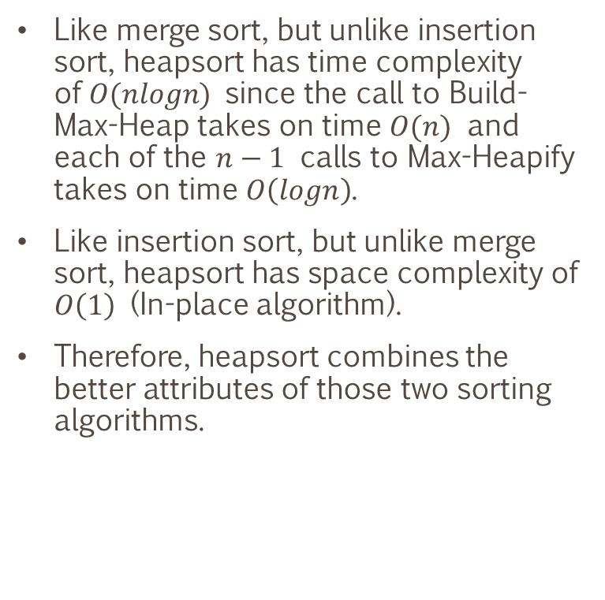
Computational Complexity
Like merge sort, but unlike insertion sort, heapsort has time complexity of$O(nlogn)$ since the call to Build-Max-Heap takes on time $O(n)$ and each of the $n−1$ calls to Max-Heapify takes on time $O\left(logn\right)$.
Like insertion sort, but unlike merge sort, heapsort has space complexity of $O\left(1\right)$ (In-place algorithm).
Therefore, heapsort combines the better attributes of those two sorting algorithms.
Procedure Max-Heapify($A$: array of real numbers, $i$: positive integer)
$l≔2i$
$r≔2i+1$
if $l≤A.heapsize$ and $A[l]>A[i]$
$largest≔l$
else
$largest≔i$
if $r≤A.heapsize$ and $A[r]>A[largest]$
$largest≔r$
if $largest≠i$
swap $A[i]$ with $A[largest]$
Max-Heapify($A, largest$)
Procedure Build-Max-Heap($A$: array of real numbers)
$A.heapsize≔A.length$
for $i≔\left\lfloor {A.length}/2\right\rfloor$ downto $1$
Max-Heapify($A, i$)
Procedure Heapsort($A$: array of real numbers)
Build-Max-Heap($A$)
for $i≔A.length$ downto $2$
swap $A[1]$ with $A[i]$
$A.heapsize :=A.heapsize−1$
Max-Heapify(A,1)

Slide 54
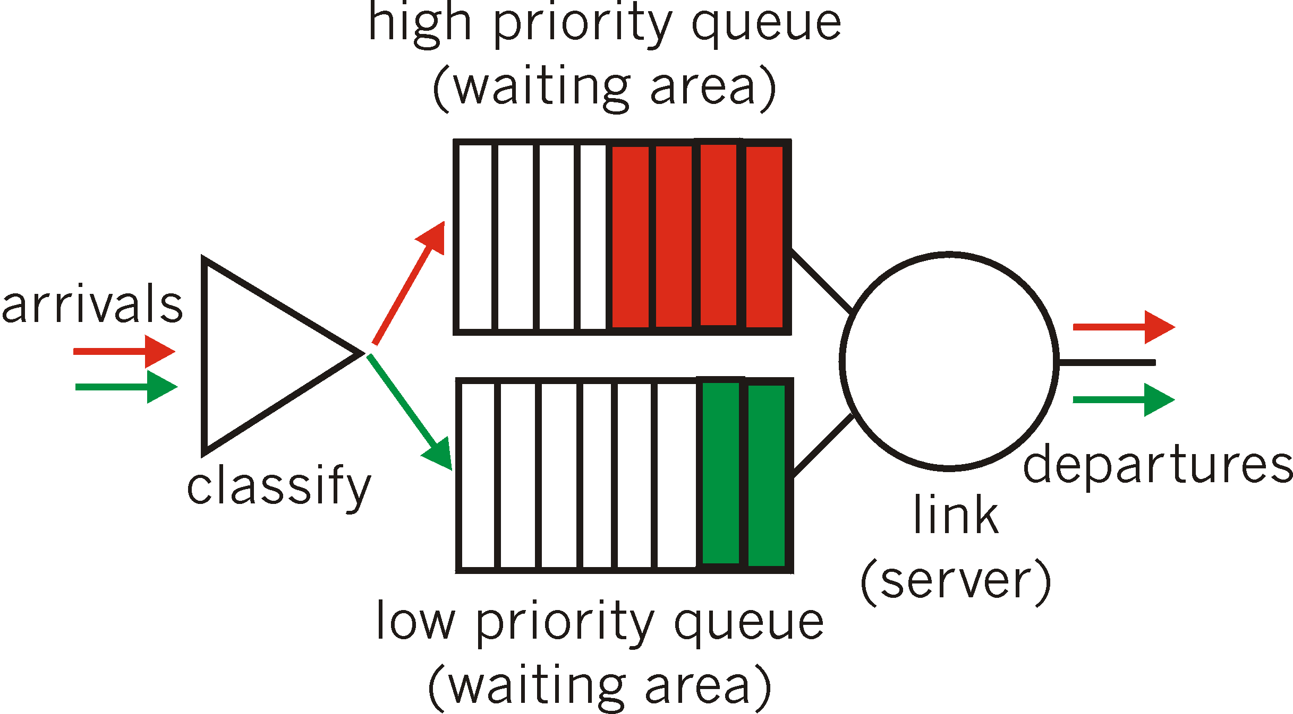
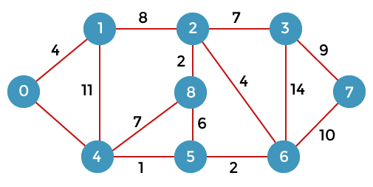
Applications of Heaps and Heapsort
Priority Queues
an abstract data-type similar to a regular queue or stack data structure in which each element has a "priority" associated with it.
Bandwidth control in a network router
Dijkstra's algorithm: Shortest paths between nodes in a graph.
Huffman coding: commonly used for lossless data compression.
Breadth-first search (BFS) algorithm
Order statistics
The Heap data structure can be used to efficiently find the k^{th} smallest (or largest) element in an array.
Notes:
http://www2.ic.uff.br/~michael/kr1999/6-multimedia/6_06-scheduling_and_policing.htm
https://www.javatpoint.com/dijkstras-algorithm

Slide 55
Thank you

Slide 56
References
Cormen, T. H., Leiserson, C. E., Rivest, R. L., & Stein, C. (2009). Introduction to algorithms. Mit Press.
“Heapsort.” Wikipedia, Wikimedia Foundation, 21 Apr. 2022, https://en.wikipedia.org/wiki/Heapsort.
“Heapsort.” GeeksforGeeks, 18 May 2022, https://www.geeksforgeeks.org/heap-sort/.
Anand, Gaurish. “Applications of Heap - Data Structure.” Coding Ninjas CodeStudio, Coding Ninjas, https://www.codingninjas.com/codestudio/library/applications-of-heap-data-structure.

